Slide 1
CAPSTONE (ECE4099)
STACKOVERFLOW ASSISTANT CHATBOT USING NLP
17BEC0114 – S ARUN KARTHIK
17BEC0125 – JASMINE BATRA
17BEC0227 – SHIV MAKADIA

Slide 2

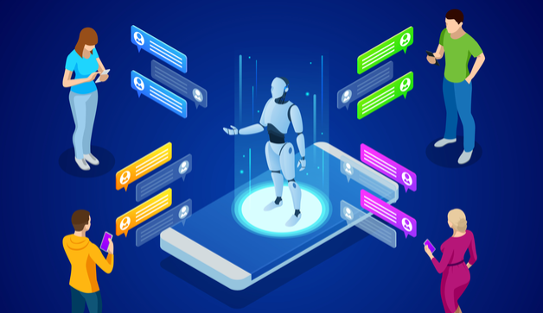

Slide 3

NATURAL LANGUAGE PROCESSING
Natural language processing (NLP) is the ability of a computer program to understand human speech as it is spoken.
NLP is a component of artificial intelligence .
It makes computer to perform useful tasks with the natural languages humans use.
Current approaches to NLP are based on machine learning.
The input and output of an NLP system can be − Speech, Written Text.

Slide 4
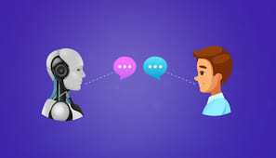
CHATBOT
A computer program that can talk to humans in natural language.
They are simulations which can understand human language, process it and interact back with humans while performing specific tasks.
Uses Artificial Intelligence Markup Language (AIML) to represent knowledge.

Slide 5
CHATBOT
We can logically divide of Chatbots in the following two categories.
Database/FAQ based — We have a database with some questions and answers, and we would like that a user can query the database using Natural Language.
Chit-Chat Based — Simulate dialogue with the user.
There are mainly two approaches used to design the Chatbots:
In a Rule-based approach, a bot answers questions based on some rules on which it is trained on. The rules defined can be very simple to very complex. The bots can handle simple queries but fail to manage complex ones.
Self-learning bots are the ones that use some Machine Learning-based approaches and are definitely more efficient than rule-based bots. These bots can be further classified in two types: Retrieval Based or Generative.

Slide 6
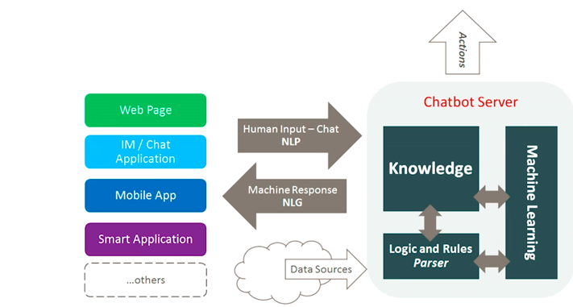
ANATOMY OF A CHATBOT (medium.com)

Slide 7
OUR OBJECTIVE
We will create a dialogue Chatbot, which will be able to:
Answer programming-related questions (using StackOverflow dataset)
Chit-Chat and simulate dialogue on all non-programming related questions
We will host it on AWS and integrate the bot to Telegram messenger so that we can now talk to this bot in Telegram.
The bot will determine the intent and distinguish programming related questions from general ones .
The bot will respond to the programming question asked by tagging it with the corresponding programming language and find the most relevant Stack-Overflow Link.
For general questions, the chatterbot will handle it.

Slide 8
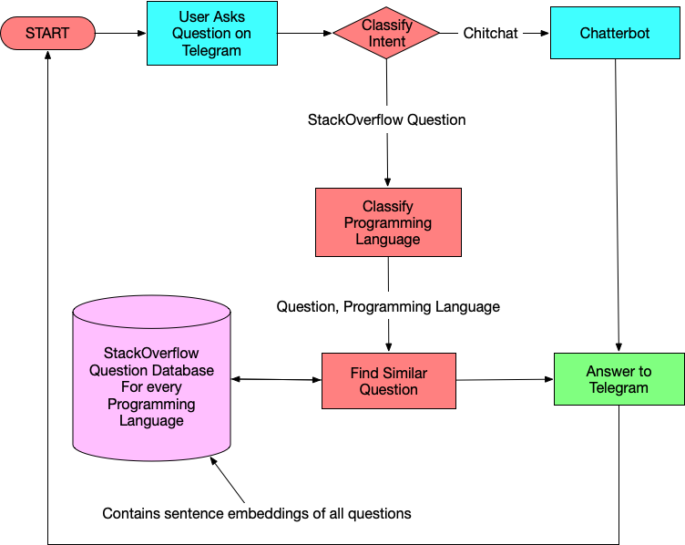
BLOCK DIAGRAM

Slide 9
TOOLS
Resources to build our Chatbot.
GOOGLE COLAB to train the model.
STACKOVERFLOW dataset.
CHATTERBOT, a Python library to generate automated responses to a user’s input for Chitchat type questions for our Chatbot.
TELEGRAM to instantiate the bot, by creating a Chatbot UI and connecting it to telegram app backend and run our Chatbot logic.
AWS to host the Chatbot.

Slide 10
LITERATURE SURVEY
N. N. Khin and K. M. Soe, "Question Answering based University Chatbot using Sequence to Sequence Model," 2020 23rd Conference of the Oriental COCOSDA International Committee for the Co-ordination and Standardisation of Speech Databases and Assessment Techniques (O-COCOSDA), Yangon, Myanmar, 2020, pp. 55-59.
In the paper, the authors explored the ways of communication through neural network chatbot by using the Sequence to Sequence model with Attention Mechanism based on RNN encoder decoder model.
This chatbot is intended to be used in university education sector for frequently asked questions about the university and its related information.

Slide 11
LITERATURE SURVEY
B. Setiaji and F. W. Wibowo, "Chatbot Using a Knowledge in Database: Human-to-Machine Conversation Modeling," 2016 7th International Conference on Intelligent Systems, Modelling and Simulation (ISMS), Bangkok, 2016, pp. 72-77.
In this paper the machine has been embedded knowledge to identify the sentences and make a decision itself as response to answer a question.
This work uses bigram for sentence similarity calculation which divides input sentence as two letters of input sentence. The higher the score obtained the more is the similarity of reference sentences.
The knowledge of chatbot is stored in the database. The chatbot consists of core and interface that is accessing that core in relational database management systems (RDBMS).

Slide 12
REFERENCES
[1] N. N. Khin and K. M. Soe, "Question Answering based University Chatbot using Sequence to Sequence Model," 2020 23rd Conference of the Oriental COCOSDA International Committee for the Co-ordination and Standardisation of Speech Databases and Assessment Techniques (O-COCOSDA), Yangon, Myanmar, 2020, pp. 55-59.
[2] B. Setiaji and F. W. Wibowo, "Chatbot Using a Knowledge in Database: Human-to-Machine Conversation Modeling," 2016 7th International Conference on Intelligent Systems, Modelling and Simulation (ISMS), Bangkok, 2016, pp. 72-77.
[3] L. T. Hien, L. Tran Thi Ly, C. Pham-Nguyen, T. Le Dinh, H. Tiet Gia and L. N. Hoai Nam, "Towards Chatbot-based Interactive What- and How-Question Answering Systems: the Adobot Approach," 2020 RIVF International Conference on Computing and Communication Technologies (RIVF), Ho Chi Minh, Vietnam, 2020, pp. 1-3, doi: 10.1109/RIVF48685.2020.9140742.

Slide 13
THANK YOU

